Slide 1


At
Apnabiz
Success opportunity presentation (sop)
The Caring Family

Slide 2

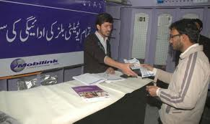
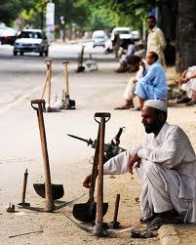


Facts About Life
And our dreams !!
Unstable jobs
High Utility bills
Unemployment
No money to
start business
Poor Schooling

Slide 3


Are you ready to change your life?!
Then
The only Solution
Just few efforts with
ApnaBiz
And start making
Your all dreams come
TRUE!!!

Slide 4
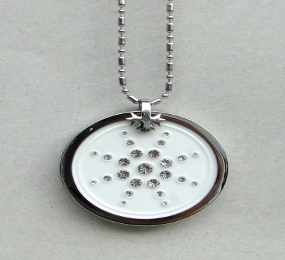


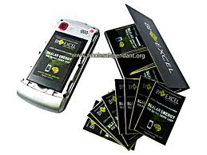
APNA products & Prices
Rs. 6300/-
Rs. 6300/-
Rs. 4900/-

Slide 5
Difference between
Traditional
&
Direct marketing

Slide 6



Formula of
Manufacturing cost
Of product
Retail price
Minus
80% of
Retail price
consumer
retailer
small
Whole seller
Saving all
Middle expenses
big
Whole seller
Advertising
publishing
regional
distributor
Country
distributor
industry
Factory
manufacturer

Slide 7
Apna Bonus Plan
Is limited upto
12th level in depth
But
UNLIMITED
In width

Slide 8







A
P
N
A
I
N
C
O
M
E
P
L
A
N
DIRECT
Direct
Sales
For
Each
Direct
Rs. 500

Slide 9



Rs. 500/- for each single direct referral which is unlimited
Level-1
Level-2
Rs. 200/- on each referral
Level-3
Rs. 120/- on each referral
Level-4
Rs. 120/- on each referral
Level-5
Rs. 110/- on each referral
Level-6
Rs. 110/- on each referral
Level-7
Rs. 100/- on each referral
Level-8
Rs. 100/- on each referral
Level-9
Rs. 100/- on each referral
Level-10
Rs. 100/- on each referral
Level-11
Rs. 100/- on each referral
Level-12
Rs. 100/- on each referral

Slide 10


APNA
Additional Earnings
For Achievers
1. Fast Cash
2. Leadership Income
3. Royalty Bonus

Slide 11


Apna
Fast Cash
You will earn
10% additional
of the collective bonus of
Your direct referrals
By referring
Minimum TWO Direct Referrals
in one week

Slide 12




Apna Leadership Income
5 Direct Referrals in 2 weeks
Rs. 200/- from each sale
Globally will be deposited
In Special Pool
Which will be equally
Distributed Among ACHIEVERS

Slide 13


Apna
Royalty Bonus
Level-1
Rs. 100/- out of
Apna Global Sale
will be deposited In Royalty Pool
Which will be equally
Distributed Among
ACHIEVERS
Level-12
Crossed

Slide 14


Bonus Distribution Schedule
Closing: Every Friday
Bonus: Every Saturday

Slide 15


Apna
Rewards
CRITERIA
Not more than 50%
Of required sales
In any line

Slide 16


Apna Reward-1
Hi-Speed
70cc Bike
For just
65 sales
Only

Slide 17

Apna Reward-2
Brand New LapTop
For just
300 sales

Slide 18


Apna Reward-3
UMRAH
(Stay + Ticket)
For just
800 sales

Slide 19

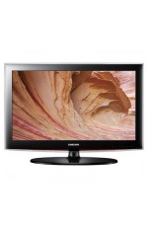
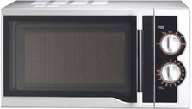

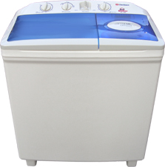

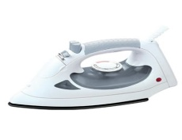
Apna Reward-4
Home Package
For just
2000 sales

Slide 20



Apna Reward-5
Suzuki Mehran
For just
7000 sales

Slide 21

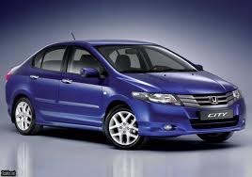
Apna Reward-6
Honda City
For just
14000 sales

Slide 22





Apna Grand
Reward
House Fund
Rs. 25 Lac
For just
28000 sales

Slide 23




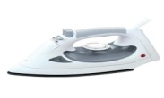

What you Get?
By Minimum work with ApnaBiz
Level | Sales | Rate | Your Income
1 | 2 | 500/- | 1000
2 | 4 | 200/- | 800
3 | 8 | 120/- | 960
4 | 16 | 120/- | 1920
5 | 32 | 110/- | 3520
6 | 64 | 110/- | 7040
7 | 128 | 100/- | 12800
8 | 256 | 100/- | 25600
9 | 512 | 100/- | 51200
10 | 1024 | 100/- | 102400
11 | 2048 | 100/- | 204800
12 | 4096 | 100/- | 409600
 | 8192 | Total Rs. | 821640
Your Income
On just TWO
Sales per week
UMRAH

Slide 24

Apna Great News
For You

Slide 25


Re-Purchasing Opportunity
You will enjoy huge discount
On re-purchasing the products
For Rs. 4300/- only (40 PVs)
For Rs. 4300/- only
For Rs. 2800/- only

Slide 26

Re-Purchasing by teams
(1 PV = Rs. 50/-)
Re-Purchasing by team | Your commission
Level-1 | 20%
Level-2 | 15%
Level-3 | 10%
Level-4 | 10%
Level-5 | 8%
Level-6 | 8%
Level-7 | 7%
Level-8 | 5%
Level-9 | 5%
Level-10 | 4%
Level-11 | 4%
Level-12 | 4%

Slide 27

Success Starts HERE!
JOIN NOW !
Right now today ..
ApnaBIZ offers the BEST Business
LETS GET STARTED!

Slide 28


